Slide 1
LGBTQ+ Students in Higher Education

Slide 2

Agenda
Introductions
Basic Vocabulary
Questions
Obstacles for LGBTQ+ Students

Slide 3
Basic Vocabulary

Slide 4
Vocabulary
Sex
Gender Identity
Gender Expression
Pronouns
Transitioning
Sexual and Romantic Orientation

Slide 5
Sex
Biological characteristics a person is born with
Primary sex characteristics, reproductive organs, chromosomes, hormone levels, and secondary sex characteristics
Male, Female, or Intersex
People will use “Assigned at birth”
Assigned Female/Male/Intersex at birth

Slide 6
Intersex
Intersex is the category a person can fall into when their biological characteristics aren’t typically female or male
1%- 1.7% of population is intersex
Over 70 known variations
Some are apparent at birth
Some show up as people develop
Some people live their whole life not knowing they’re intersex
InterACT: Advocates for Intersex Youth

Slide 7
Sex cont.
Not all intersex people are LGBTQ+ but a lot do identify as LGBTQ+
Sex is a spectrum
Sex naturally falls on a spectrum, humans created the boxes

Slide 8
Gender Identity
Separate from Sex
A person's own internal sense of their gender
Culturally Informed
American culture often conflates sex and gender, but they are different

Slide 9
Gender Identity cont.
Cisgender: when someone’s gender identity matches the one assigned at birth
Cis is Latin for “on the same side of”
Transgender: when someone’s gender identity is different than the one assigned at birth
Trans is Latin for “across”
Usually shortened to just “Trans”
Transgender man = Transman
Transgender woman = Transwoman
Often shortened to “Cis”
Cisgender man = Cis man
Cisgender woman = Cis woman

Slide 10
Gender Identity
Non-binary
Western culture uses a binary system of gender, with only two options: an or woman
Non-binary is a gender that is neither man or woman
Umbrella term for other gender identities like
Genderqueer
Genderfluid
Androgynous
PFLAG Glossary

Slide 11
Gender expression
Physical expression of gender. This can be through hairstyle, clothing, mannerisms, etc.
Cultural ideas of masculinity, femininity, and androgyny
Gender Expression doesn’t equal someone’s gender identity

Slide 12
Gender Expression
Our ideas of what’s considered appropriate for each gender has changed over time
Women wearing pants
Men wearing heels
Colors
Everyone has done something that is not expected for their gender
Do you remember a time you were praised and/or punished for going against the expected?

Slide 13
Pronouns
A person’s pronouns are what we use to refer to a person
Ex: He/Him/His, She/Her/Hers, They/Them/Theirs
Pronouns are not indicative of someone's gender identity
Folks can use "She/Her" pronouns and not identify as cisgender

Slide 14
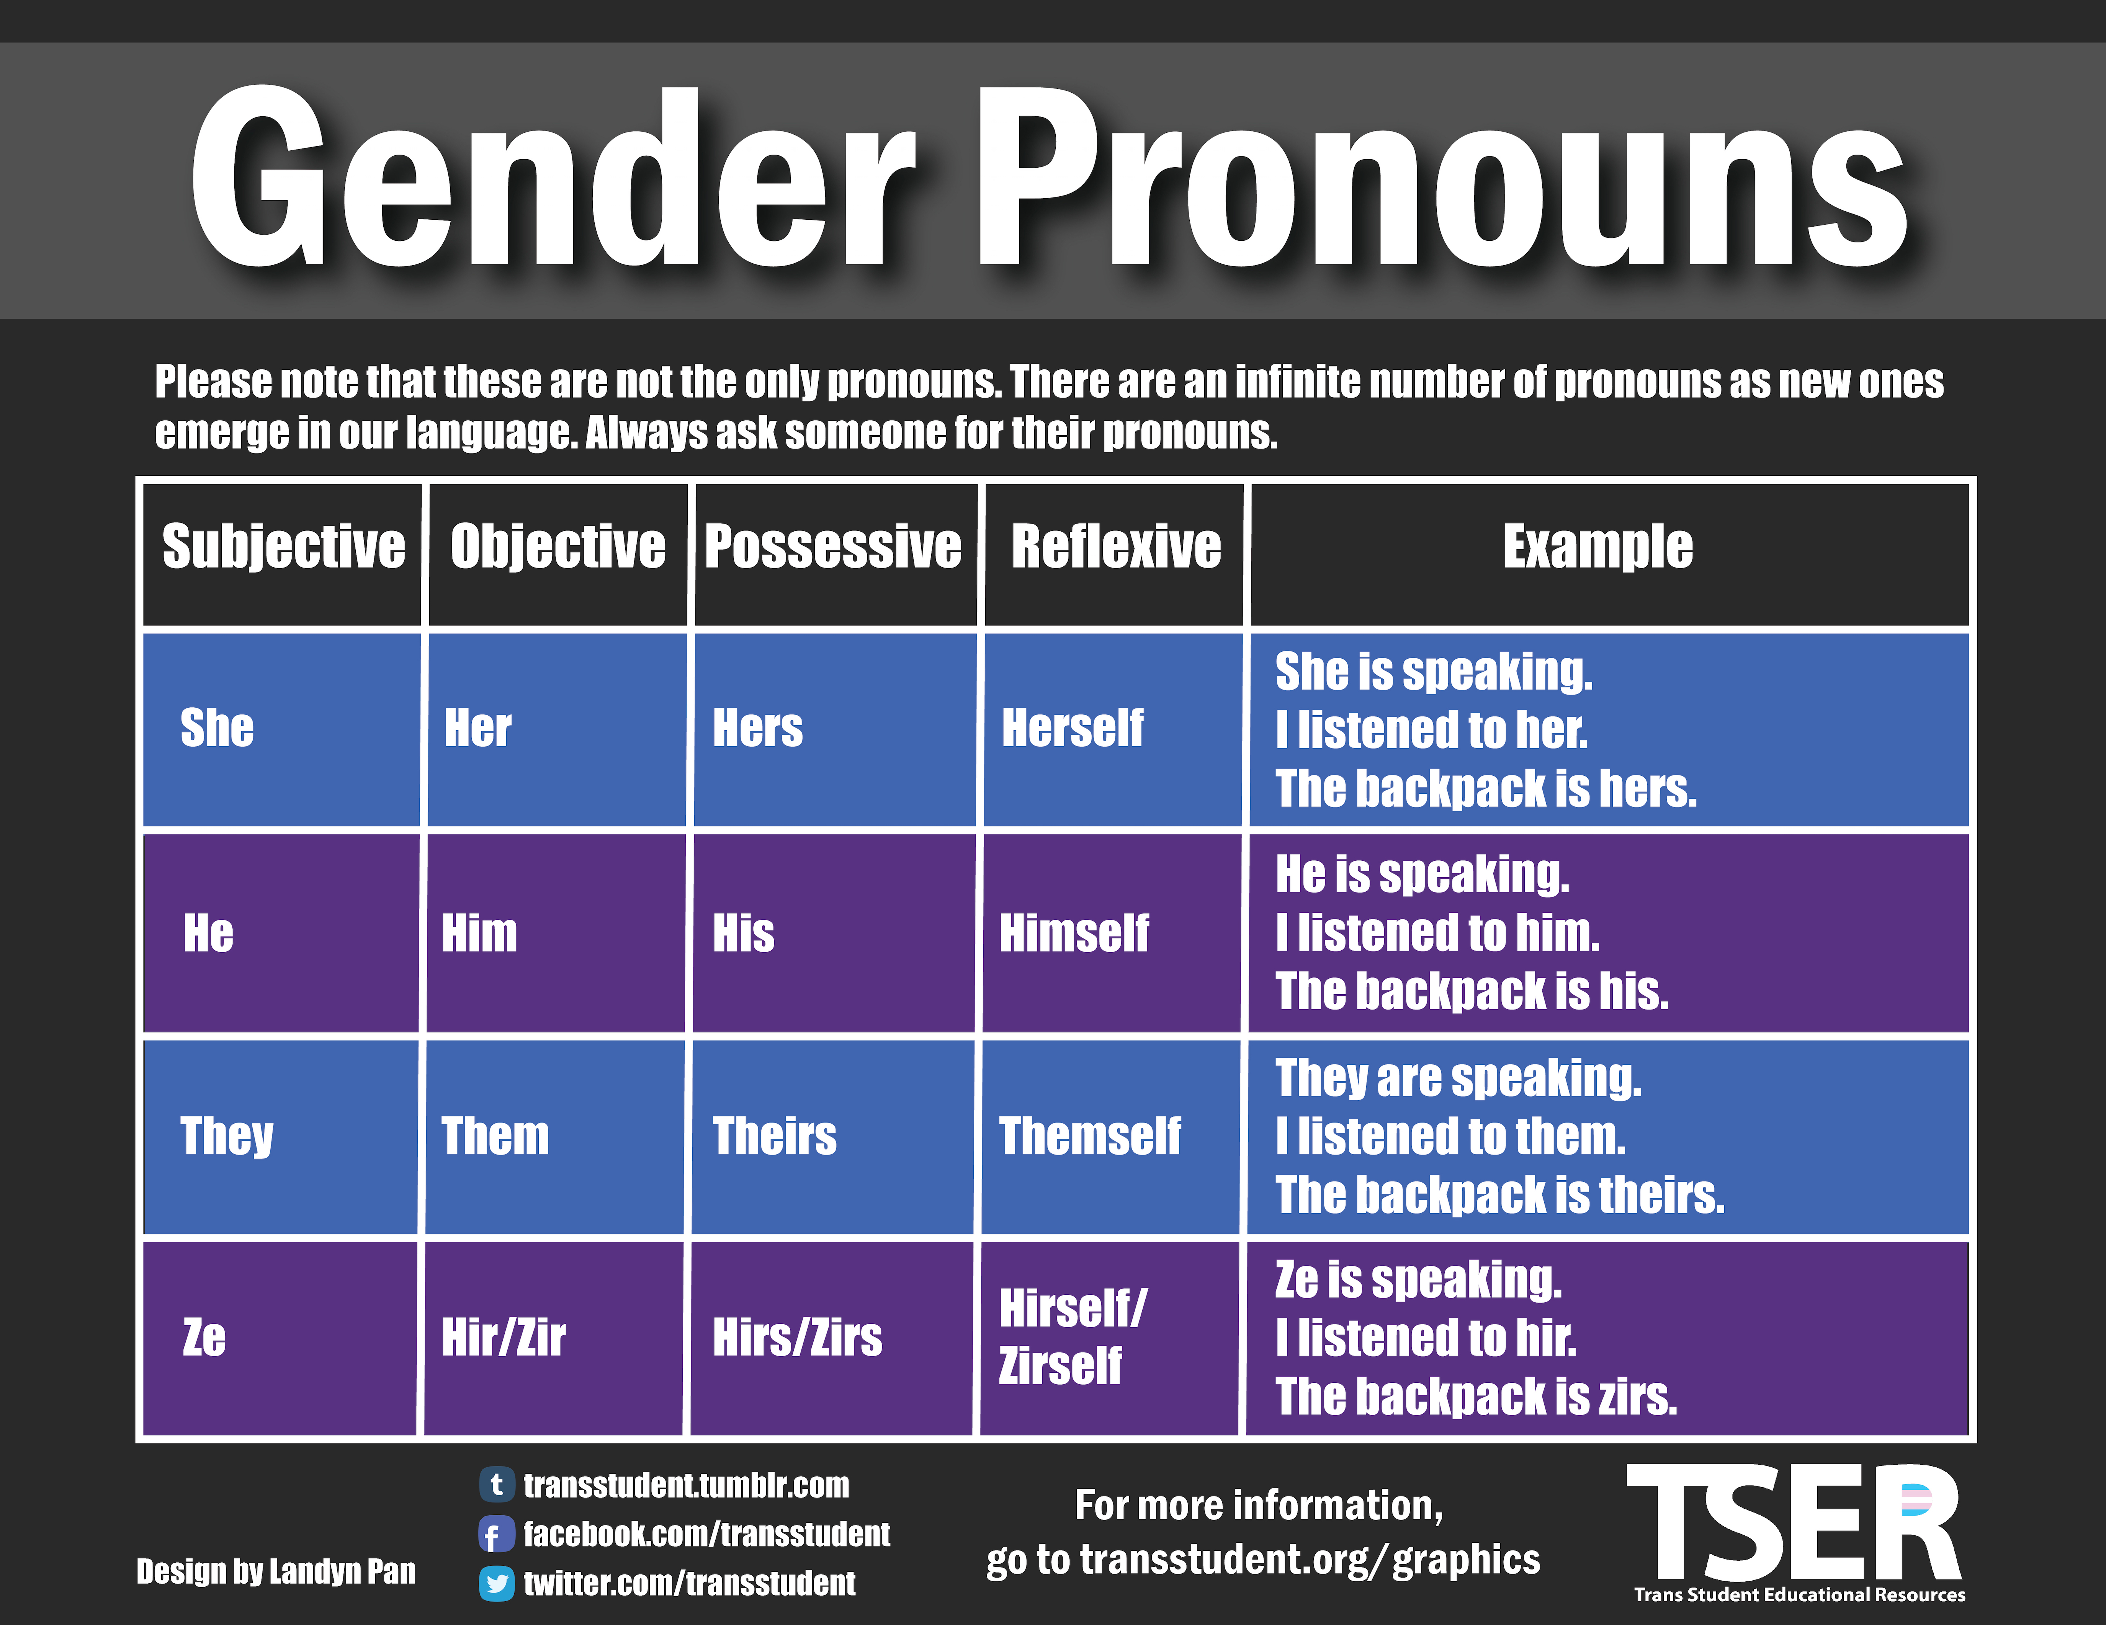
Trans Student Educational Resources is one of many sources for useful information on pronoun use!

Slide 15
Transitioning
The steps a person takes to affirm their gender identity.
Three types of Transitioning
Legal
Medical
Social
Transgender and Intersex people can choose to do this.

Slide 16
Transitioning
Legal
Process of changing legal name and/or sex marker on documents
Medical
Undergoing hormone therapy and/or having gender affirmation surgery
Social
Changing gender expression and / or going by a new name and set of pronouns
Someone can choose to do all three types or none, it’s a personal decision
It’s not always appropriate to ask about someone’s transition

Slide 17
Sexual and Romantic Orientation
Who you’re attracted to
Sexual Orientation: sexual attraction
Romantic Orientation: romantic (not necessarily sexual) attraction
Both can be the same, and often are for a lot of people. But they can also be different
Ex: A woman who is heterosexual and heteroromantic.
Ex: A man who is homosexual and biromantic

Slide 18
Sexual and Romantic Orientation cont.
I think of both like this:
Romantic orientation: who I want to go on a date with, get to know, have similar values, etc
Sexual orientation: who I would want to hook up with, and not necessarily date
Example: MSM (men who have sex with men)
MSM are men who don’t identify with “gay” or “homosexual”. This could be men who are sexually attracted to men but not romantically

Slide 19
Barriers in Education
School Officials and peers
Police violence
Bias from teachers, staff, and peers
Exclusion Consequences
Family exclusion
Peer exclusion
Compounding factors (race, ability, class, etc.)

Slide 20
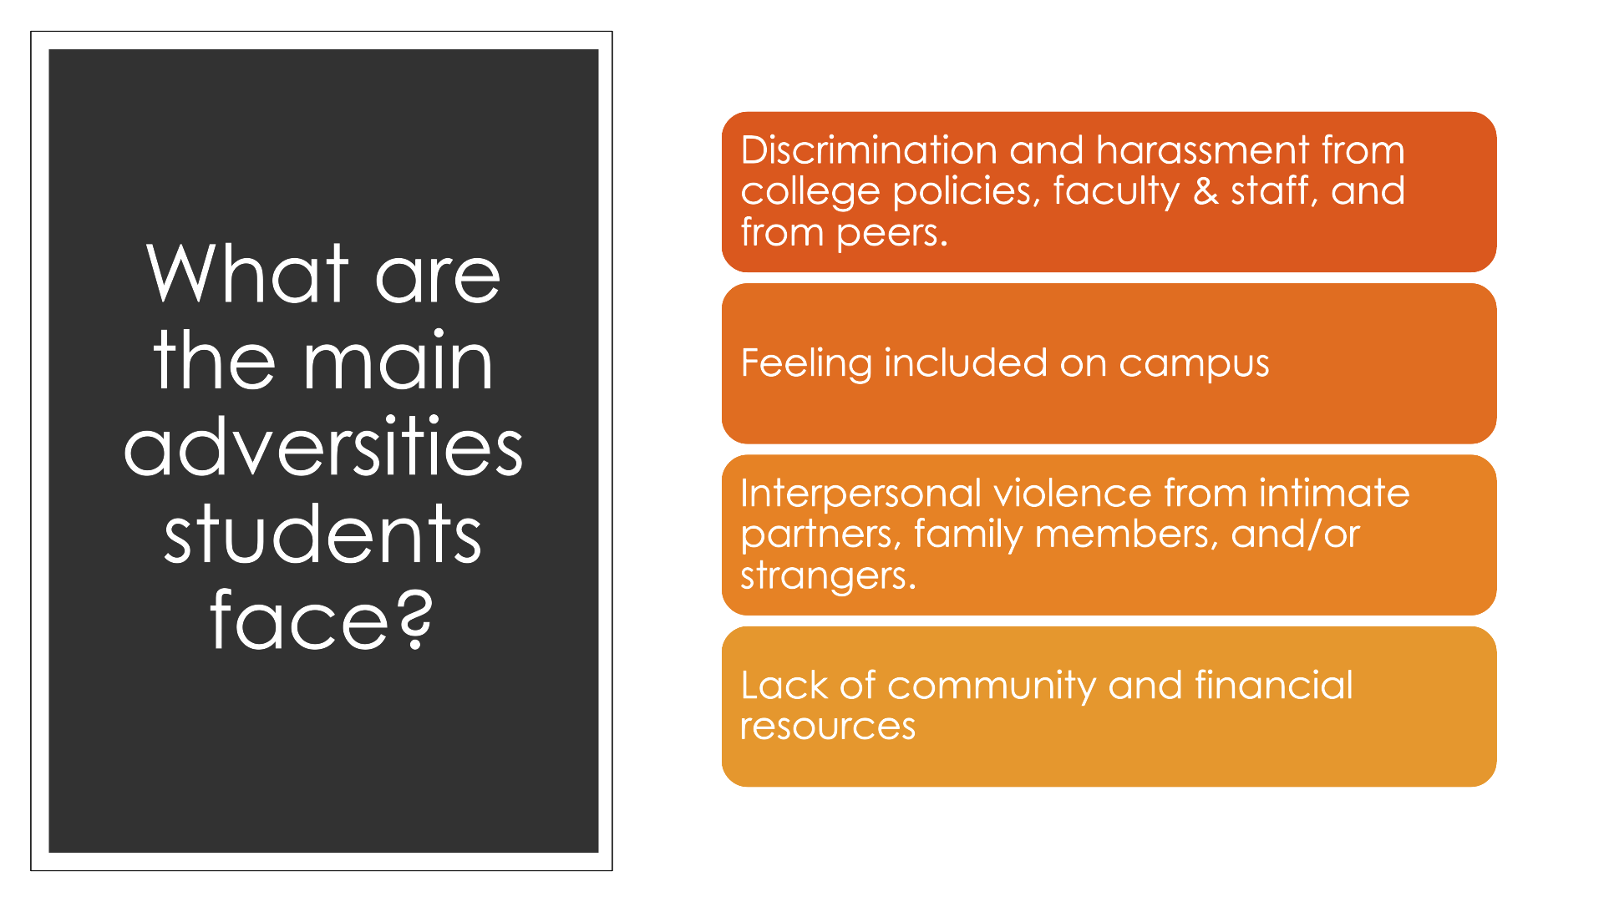

Slide 21
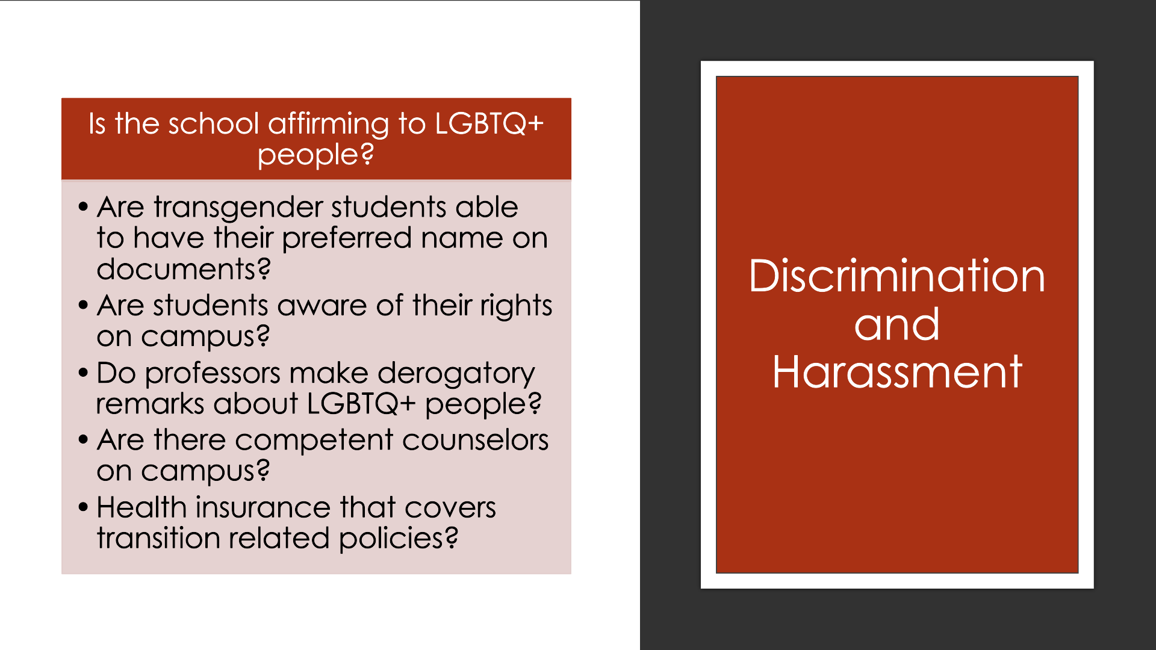

Slide 22
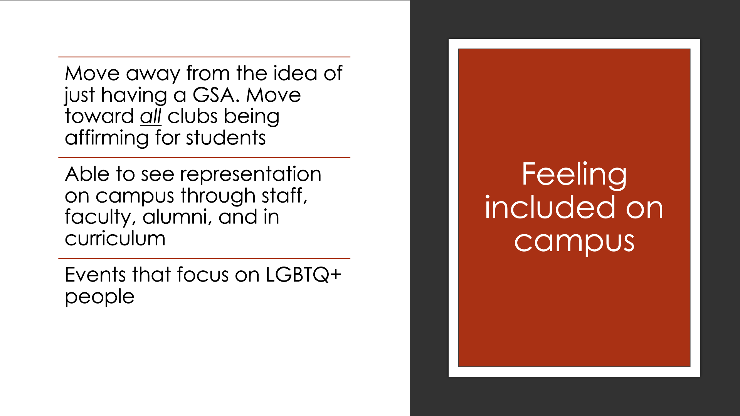

Slide 23
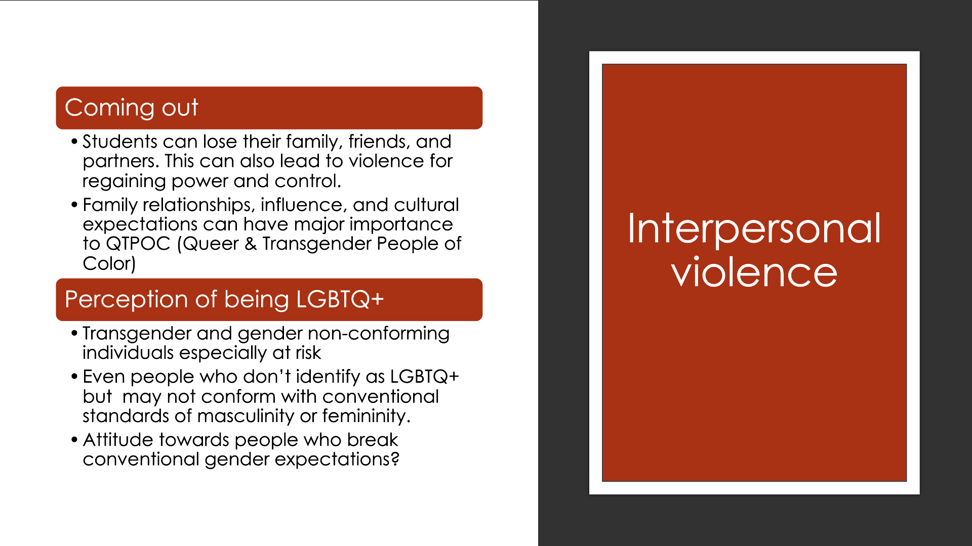

Slide 24
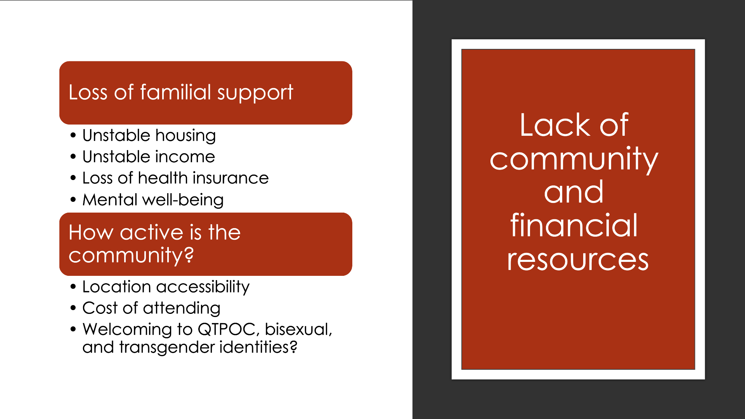

Slide 25
Consider the following
Why are there barriers in education for LGBTQ+ people in the first place?

Slide 26
Unpleasant truth
Most of the world has been colonized by Europeans
When the colonists “discovered” new land they brought their ideology too
Christianity
This became and still is the dominant gender and sexuality ideology
There is more than one way to construct a culture
Heterosexual and procreative sex only
Binary gender option

Slide 27
Cultures around the world
There are a lot of cultures that have been documented to include LGBTQ+ people in their culture
  Societies that have third gender option
  Societies with documented homosexuality and gender variation
    Ancient Egypt
    Ancient China (journal article)
    Ancient Japan
    Two-spirit people in US
      History of Two-spirit and problems with the term
    Ancient Europe

Slide 28
Contact
When colonizers saw people who were not male or female, people acting outside of their assumed gender, and people in same-sex relationships, they were intentionally persecuted and often murdered
Positions of power or importance
Connection to religion
Goes against their religion (namely Christianity)
We know this because it has been documented via journals / diary entries
Disturbing accounts

Slide 29
Over time a specific ideology took over
This ideology places cisgender and heterosexual people above people who aren’t
Laws and policies
  Sodomy laws
  Marriage laws
  “three garment rule” and “masquerade laws”

Slide 30
How this shows up in schools
Filling out forms ​
Graduation
Bullying policy ​
What students learn​
What clubs are allowed and who gets access to those spaces​
Title IX
Restrooms and lockers​

Slide 31
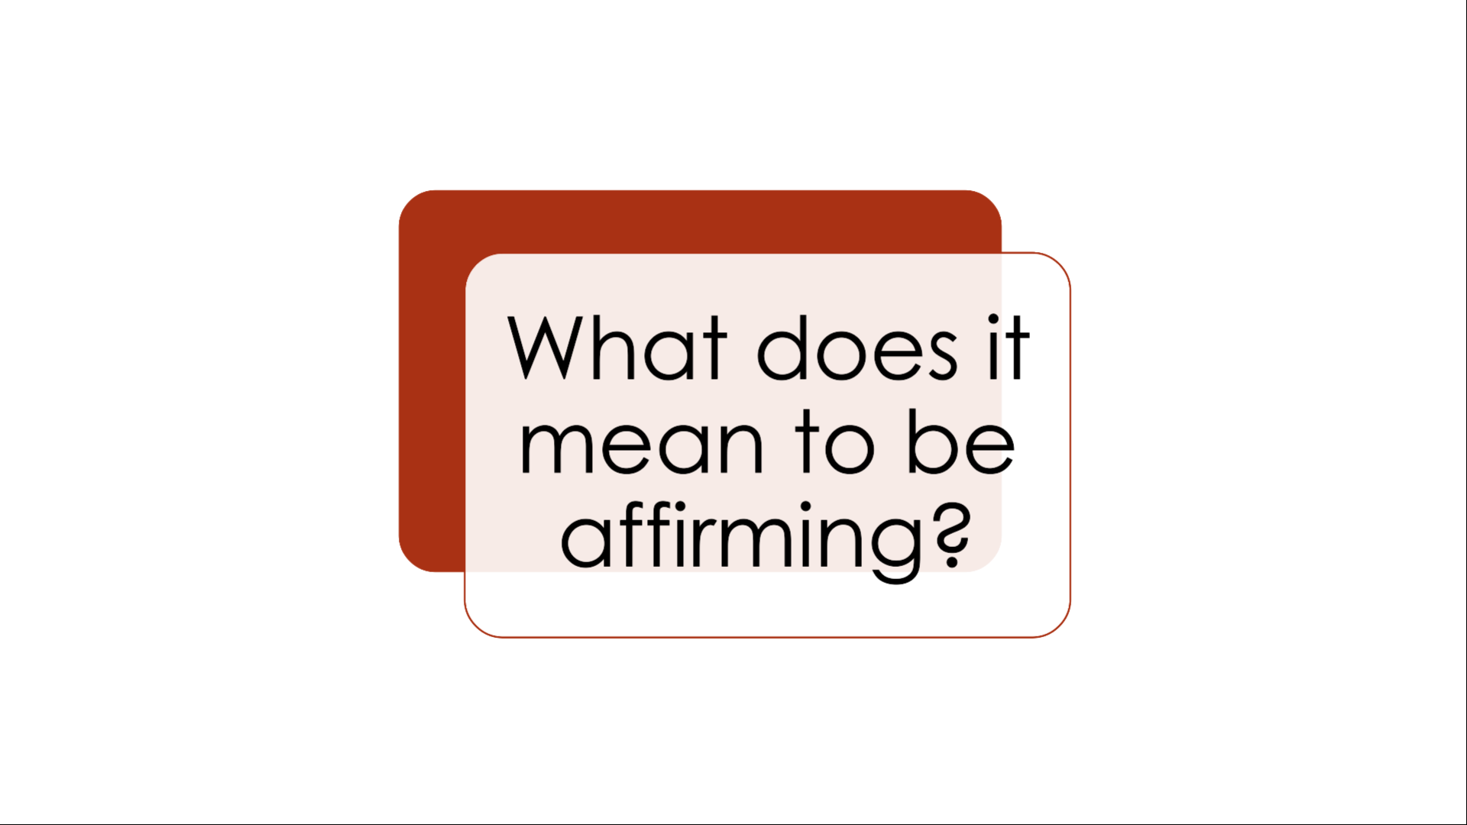

Slide 32


Slide 33
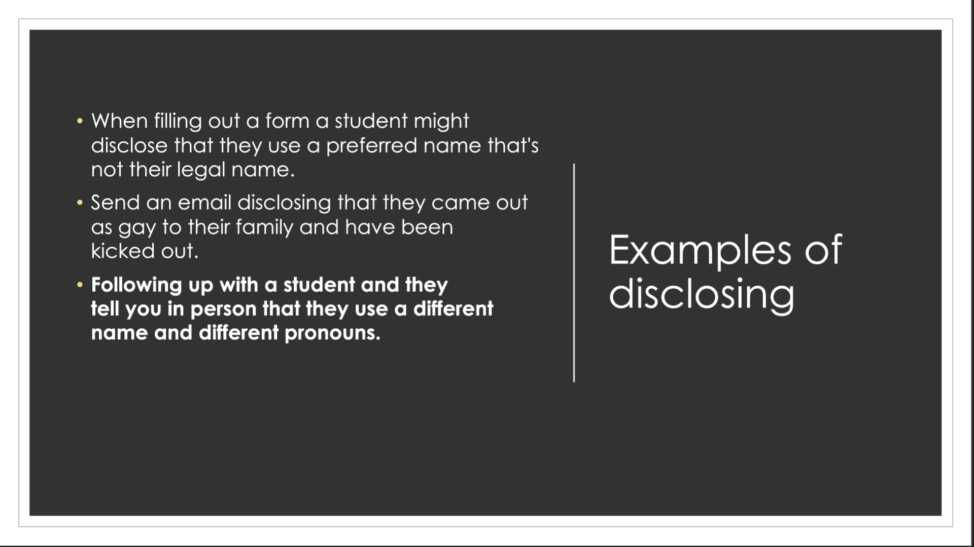

Slide 34
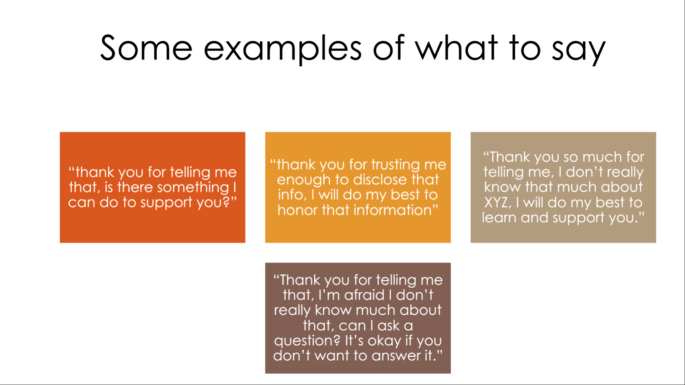

Slide 35
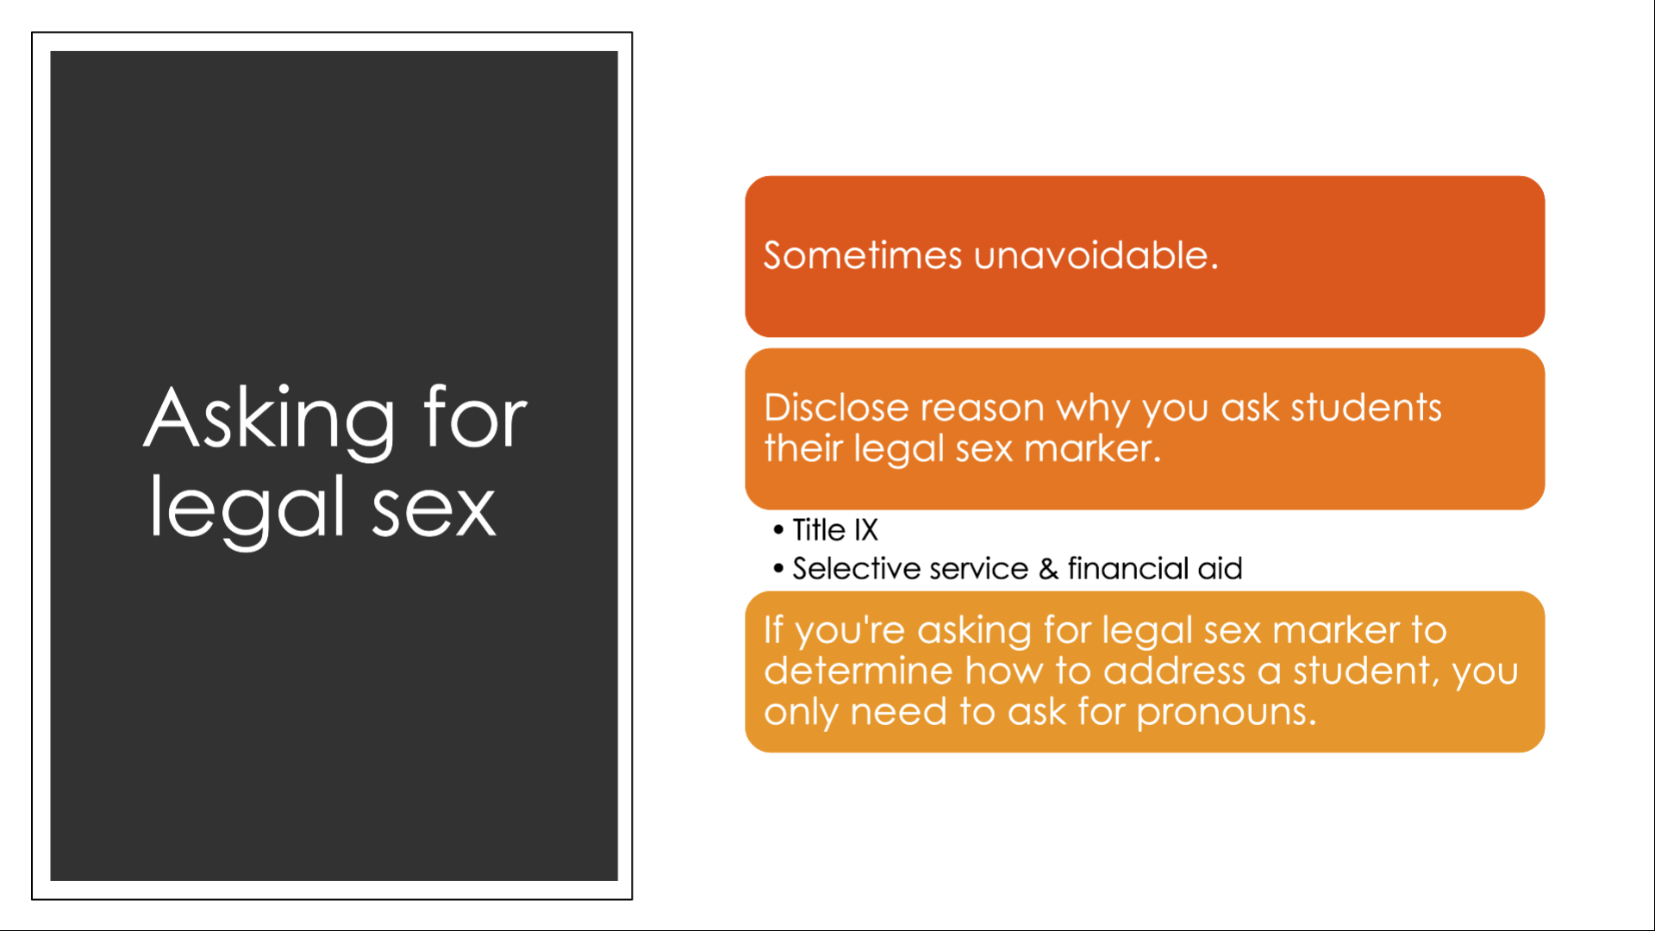

Slide 36
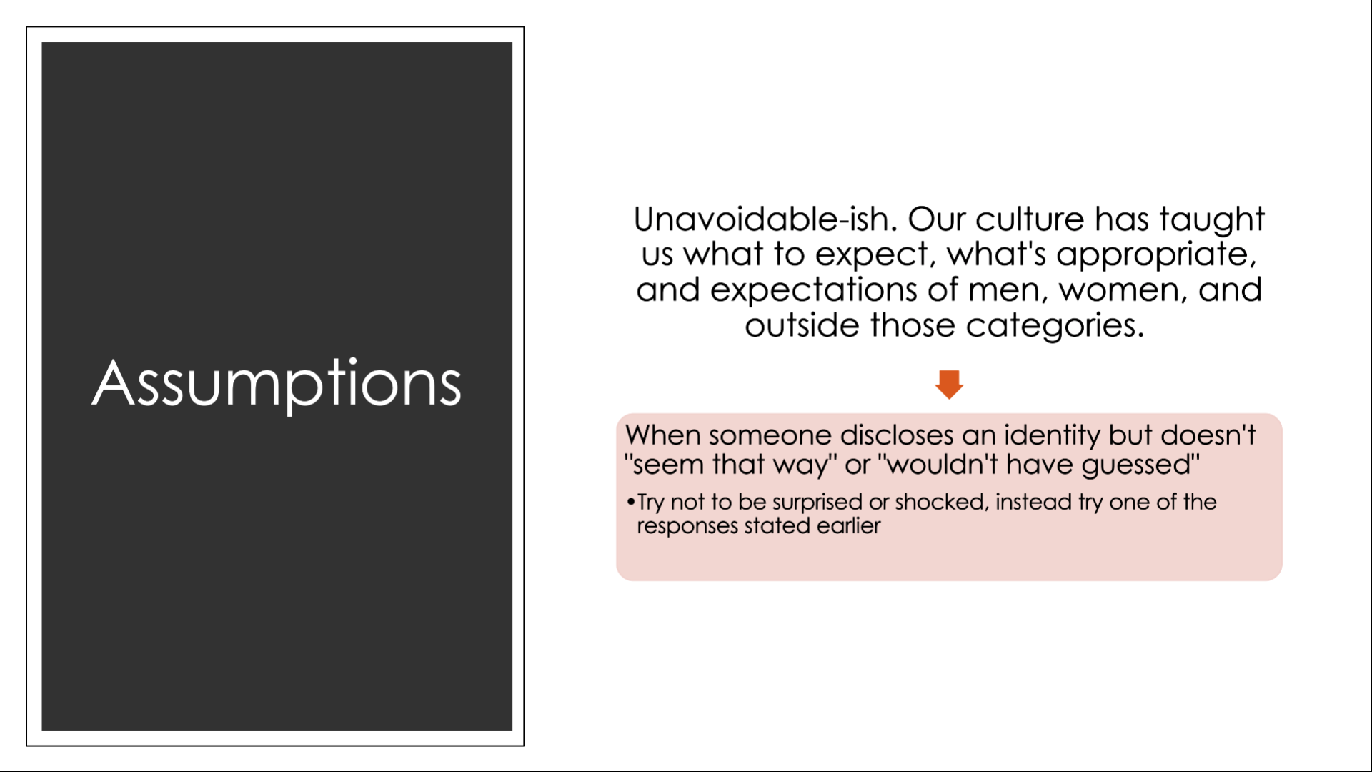

Slide 37
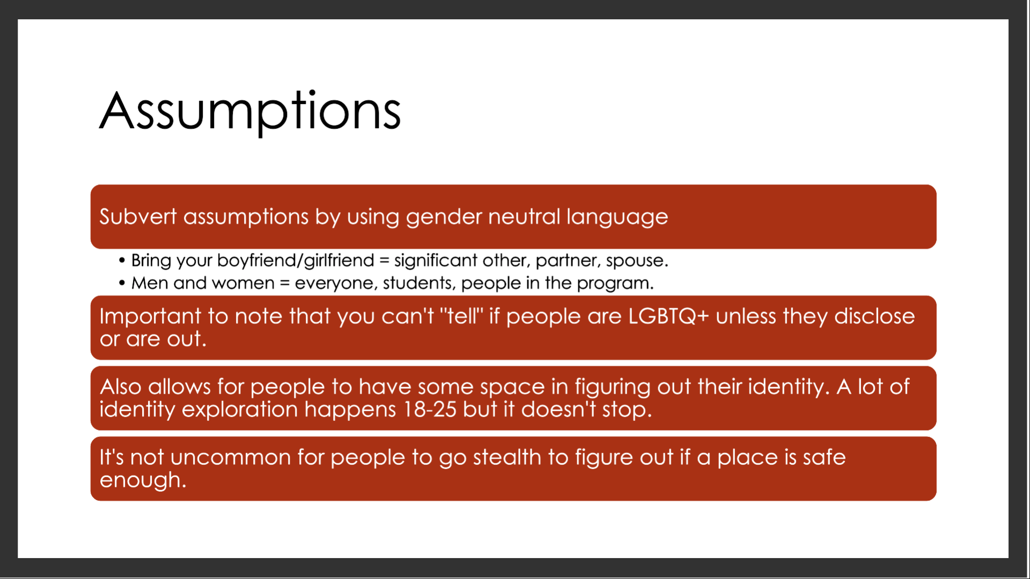

Slide 38
